Slide 1
Graph Algorithms

Slide 2
Introduction
A graph G is represented as : G = (V, E), where
|V| is the number of vertices
|E| is the number of edges
in a graph.
There are two standard ways to represent a graph
G = (V,E): as a collection of adjacency matrix or as adjacency list
Either way applies to both directed and undirected graphs.

Slide 3
Introduction
1
2
3
4
5
1
2
5
1
0
1
0
0
1
1
2
2
1
5
3
4
2
1
0
1
1
1
3
3
2
4
3
0
1
0
1
0
5
4
4
2
5
3
4
0
1
1
0
1
5
4
1
2
5
1
1
0
1
0
1
2
3
4
5
6
1
2
5
1
0
1
0
0
1
0
1
2
3
2
5
2
1
0
1
1
1
0
3
6
4
3
0
1
0
1
0
1
6
4
2
4
0
1
1
0
1
0
5
4
5
1
1
0
1
0
0
5
4
6
6
0
0
0
0
0
1
6

Slide 4
Adjacency List
The adjacency-list representation of a graph G= (V,E) consists of an array Adj of |V| lists, one for each vertex in V.
For each u ε V, the adjacency list Adj[u] contains all the vertices v such that there is an edge (u,v) ε E.
Adj[u] consists of all the vertices adjacent to u in G.

Slide 5
Adjacency
If G is a directed graph, the sum of the lengths of all the adjacency lists is |E|, since an edge of the form (u,v) is represented by having v appear in Adj[u].
If G is an undirected graph, the sum of the lengths of all the adjacency lists is 2|E|, since if (u,v) is an undirected edge, then u appears in v’s adjacency list and vice versa.
For both directed and undirected graphs, the adjacency-list representation has the desirable property that the amount of memory it requires is θ(V + E)

Slide 6
Adjacency
We can readily adapt adjacency lists to represent weighted graphs, where each edge has a weight.
The weight is typically given by a weight function
w: E ℜ
Let G = (V, E) be a weighted graph with weight function w.
We simply store the weight w(u,v) of the edge (u, v) ℇ E with vertex v in u’s adjacency list.
The adjacency-list representation is quite robust in that we can modify it to support many other graph variants.

Slide 7
Adjacency
A potential disadvantage of the adjacency-list representation is that it provides no quicker way to determine whether a given edge (u,v) is present in the graph than to search for v in the adjacency list Adj[u].
An adjacency-matrix representation of the graph remedies this advantage but at the cost of using more memory.

Slide 8
Adjacency
For the adjacency-matrix representation of a graph G = (V,E), we assume that the vertices are numbered 1,2,….,|V| in some arbitrary manner.
Then the adjacency-matrix representation of a graph G consists of |V| x |V| matrix A = (aij) such that
aij = {
The adjacency matrix of a graph requires θ (V²) memory, independent of the number of edges in the graph.
1
if (i, j) ℇ E,
0
otherwise.

Slide 9
Adjacency
In an undirected graph, (u,v) and (v,u) represent the same edge, the adjacency matrix A of an undirected graph is its own transpose: A = A^{T}
In some applications it pays to store only the entries on and above the diagonal of the adjacency matrix, thereby cutting the memory needed to store the graph almost in half.

Slide 10
Weighted Graph
Like the adjacency list representation of graph, an adjacency matrix can represent a weighted graph.
For example, if G = (V, E) is a weighted graph with edge-weight function w, we can simply store the weight w(u,v) of the edge (u,v) ℇ E as the entry in row u and column v of the adjacency matrix.
If an edge does not exist, we can store NIL value as its corresponding matrix entry
For some problems it is convenient to use a value such as 0 or ∞

Slide 11
Adjacency-list vs. adjacency-matrix
The adjacency-list is asymptotically at least as space efficient as the adjacency matrix.
Adjacency matrices are simpler so we may prefer them when graphs are reasonably small.
Moreover, adjacency matrices carry a further advantage for unweighted graphs; they require only one bit per entry.

Slide 12
Breadth-First Search
BFS is one of the simplest algorithms for searching a graph.
Other algorithms include Prim’s minimum-spanning-tree algorithm and Dijkstra’s single-source shortest-paths algorithm.
Given a graph G = (V, E) and a distinguished source vertex s, breadth-first search systematically explores the edges of G to discover every vertex that is reachable from s.

Slide 13
Breadth-First Search
It computes the distance from s to each reachable vertex.
It also produces a “breadth-first tree” with root s that contains all reachable vertices.
For any vertex v reachable from s, the simple path in the breadth-first tree from s to v corresponds to a shortest path from s to v in G, that is, a path containing the smallest number of edges.
This algorithm works on both directed and undirected graphs.

Slide 14
Breadth-First Search
It expands the frontier between discovered and undiscovered vertices uniformly across the breadth of the frontier.
The algorithm discovers all vertices at distance k from s before discovering any vertices at distance k + 1.
It keeps progress by coloring each vertex as white, gray or black.
All vertices start out white, and may later become gray, or black

Slide 15
Breadth-First Search
A vertex is discovered when encountered in search.
Its color is changed to nonwhite.
Gray and black vertices have been discovered
BFS distinguishes between them to ensure breadth first search.
If (u,v) ∈ E and vertex u is black, then vertex v is either gray or black.
All vertices adjacent to black have been discovered
Gray vertices may have some adjacent white vertices.
Grays represents the frontier between discovered and undiscovered vertices.

Slide 16
Breadth-First Search
A breadth-first tree is constructed
Initially there is only root (source vertex, s)
When search discovers v (white vertex) in the course of discovering the adjacency list of an already discovered vertex u, the vertex v and the edge (u, v) are added to the tree.
u is the predecessor or parent of v in the breadth-first tree.
Since a vertex is discovered at most once, it has at most one parent.

Slide 17
Breadth-First Search
Ancestor and descendant relationships in the breadth-first tree are defined relative to the root s as usual.
If u is on the simple path in the tree from the root s to vertex v, then u is an ancestor of v and v is a descendant of u.
The BFS algorithm assumes the input graph, G = (V, E) is represented using adjacency lists.
Color of each vertex u ∈ V is stored as u.color
Predecessor of u as u.π
If u has no predecessor the u.π = NIL.
u.d holds the distance from the source s to vertex u.
Algorithm also uses a queue, Q to manage the set of gray vertices.

Slide 18
Breadth-First Search
BFS (G, s)
for each vertex u ∈ G.V - {s}
u.color = WHITE
u.d = ∞
u.π = NIL
s.color = GRAY
s.d = 0
s.π = NIL
Q = ∅
Enqueue(Q,s)
while Q ≠ ∅
u = Dequeue(Q)
for each v ∈ G.Adj[u]
if v.color == WHITE
v.color = GRAY
v.d = u.d + 1
v.π = u
Enqueue(Q,v)
u.color = BLACK

Slide 19
Breadth-First Search
With the exception of the source vertex s, paint every vertex white
Set u.d to infinity for each vertex u and set the parent of every vertex to be NIL.
Then, paint s gray.
Initialize s.d to 0
Set predecessor of the source to be NIL.
Initialize Q with just the vertex s.

Slide 20
Breadth-First Search
While loop iterates as long as there remain gray vertices.
These are discovered vertices that have not had their adjacency lists fully examined.

Slide 21
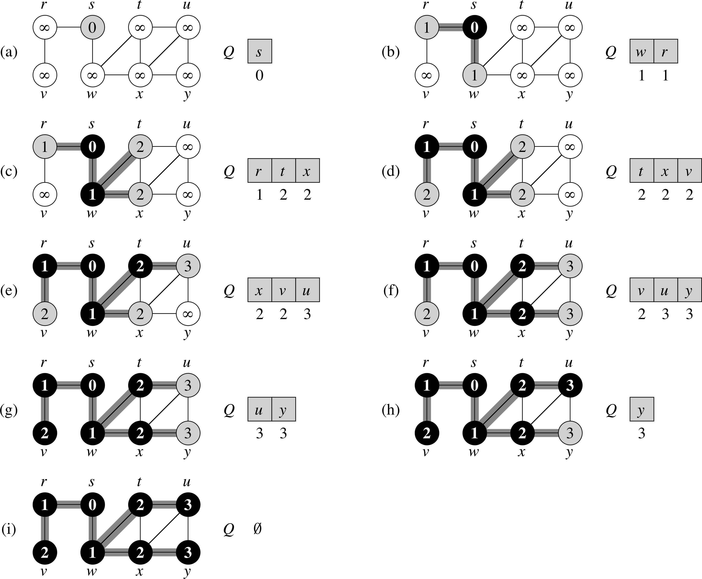
Breadth-First Search

